Slide 1




School of Computer Science and Engineering
Department of Computer Science and Engineering
Bioclassify
Bio-Inspired Generative Optimization for Gene-Based Disease Classification
Submitted By:?
Tanishq Goel
2427030744
Supervised By:?Dr. Gireesh Kumar

Slide 2

Introduction
In recent times, the classification of diseases based on genes has acquired considerable significance in the medical field of artificial intelligence. This is because it can aid in the early diagnosis of diseases and provide personalized treatment. However, the classification of diseases based on genes is facing a major challenge. The datasets used in gene expression consist of thousands of genes but only a few patient samples.
As a result of these high-dimensional features, conventional machine learning algorithms cannot efficiently find the most important genes. This leads to overfitting of the model, resulting in low accuracy.
In order to overcome these problems, our project introduces a new intelligent approach that integrates optimization algorithms with generative learning models. The aim of the project is to enhance the accuracy of the model in selecting genes, create new samples using generative learning, and develop a reliable disease classification system.

Slide 3
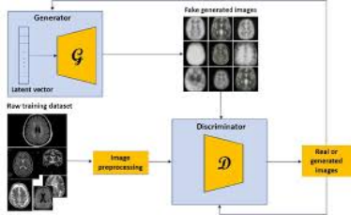
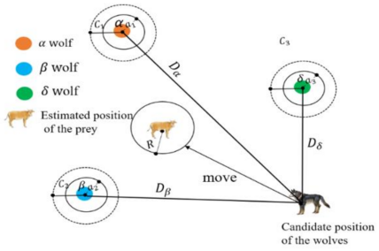
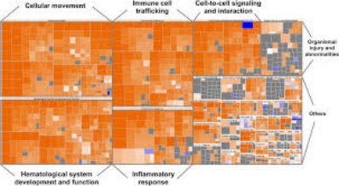

Slide 4
Literature Review
  Lately, high-throughput genomics—think microarray and single-cell RNA sequencing—has been churning out massive, high-dimensional gene expression datasets. But even with all this data, disease classification isn’t easy. There’s just so much information, too many redundant genes, classes that aren’t balanced, and a ton of biological noise. People have tried to tackle these problems using bio-inspired optimization methods like Genetic Algorithms (GA), Particle Swarm Optimization (PSO), and other evolutionary metaheuristics.
  These techniques, especially GA-based feature selection, have actually helped; they pick out smaller, more informative sets of genes and push classification accuracy up, especially in cancer studies. At the same time, deep generative models—like Variational Autoencoders (VAE), conditional VAEs, and scVI-based systems—are showing serious promise. They handle the complexity of gene expression data, strip out technical noise, and shrink the data down to something more manageable for classification.
  Recent single-cell genomics research points out how these generative models can help with clustering, representation learning, even dose response predictions. Plus, researchers have started using them to generate synthetic data, which helps balance out classes in messy biomedical datasets.

Slide 5

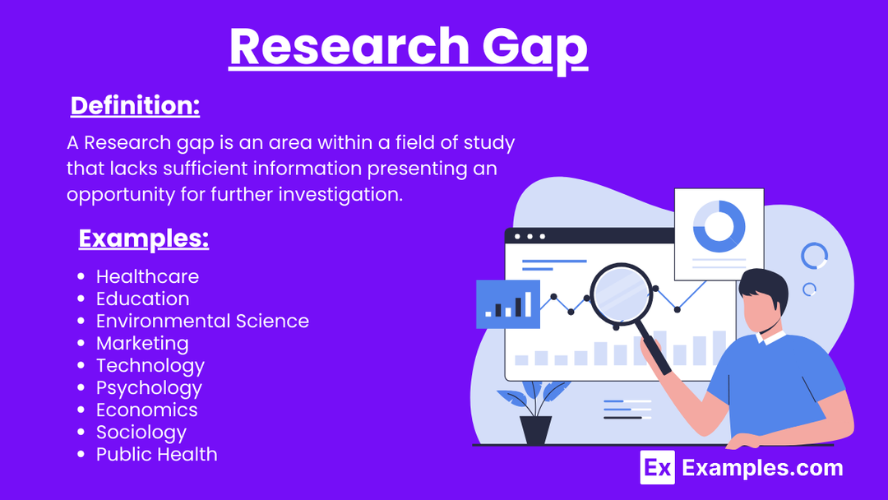
Research Gap
  After digging through around 10 research articles, it’s clear there’s a real gap: nobody’s put together a truly integrated bio-inspired generative optimization pipeline. We’re missing a framework that brings together evolutionary gene selection, deep latent-space learning, and class-balanced synthetic data generation—all in one place—for robust disease classification. There’s a real need for a pipeline that does the following:
  Uses bio-inspired optimization (like GA or hybrid metaheuristics) to pick out stable, biologically meaningful genes.
  Leverages deep generative models (like cVAE or scVI) for both learning latent representations and making new data.
  Looks beyond just accuracy—evaluates gene stability and pathway enrichment, too.
  Deals with class imbalance by generating synthetic samples in a controlled way. With this in mind, the proposed research aims to build a unified Bio-inspired Generative Optimization framework that connects evolutionary computation and deep generative learning.

Slide 6
Problem Statement
Gene-based disease classification suffers from high-dimensional data, limited samples, and ineffective gene selection, leading to poor prediction accuracy.
The problem is to develop a hybrid bio-inspired generative optimization approach that can select important genes, augment data, and improve disease classification performance.

Slide 7
Objectives
  Develop a hybrid system combining bio-inspired optimization and generative learning for gene-based disease classification.
  Use swarm algorithms (PSO/GWO/DE) to select the most relevant disease-related genes and reduce dimensionality.
  Apply GAN/VAE models to generate additional gene samples and handle limited medical data.
  Build an accurate and robust prediction model to support early diagnosis and clinical decision-making.

Slide 8
Proposed Methodology
  Data Collection & Preprocessing:?Public gene expression datasets (Leukemia, Colon, Prostate, etc.) are collected and normalized. Noise removal and scaling are performed to prepare the data for training.
  Generative Data Augmentation:?A generative model such as GAN or VAE is used to create synthetic gene samples. This helps overcome limited dataset size and improves model generalization.
  Bio-Inspired Gene Selection:?Swarm optimization algorithms like PSO, Grey Wolf Optimization, or Differential Evolution are applied to select the most relevant genes and reduce dimensionality.
  Disease Classification Model: The optimized gene subset is fed into a classifier (SVM, Random Forest, or Neural Network) to predict disease classes.
  Performance Evaluation: The model is evaluated using accuracy, precision, recall, F1-score, and comparison with baseline methods.

Slide 9

Hybrid Solution: Novel Approach
  Generative Deep Learning:
Leveraging Variational Autoencoders (VAEs) and Generative Adversarial Networks (GANs) for data augmentation.
  Bio-Inspired Swarm Optimization:
Utilizing Particle Swarm Optimization (PSO), Grey Wolf Optimization (GWO)
and Differential Evolution (DE) for intelligent feature selection.

Slide 10
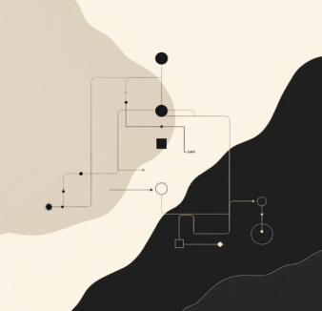
Generative Models: Tackling Small Datasets
  Variational Autoencoders (VAEs):
Compress: Encode high-dimensional gene data into a lower-dimensional latent space.
Learn Distribution: Model the probability distribution within this latent space.
Generate: Sample from the learned distribution to create synthetic, yet realistic, gene expression samples.
  Generative Adversarial Networks (GANs):
Generator: Creates synthetic gene samples.
Discriminator: Distinguishes between real and synthetic samples.
Adversarial Training: Generator improves to fool the discriminator, discriminator improves to catch the generator, leading to highly realistic synthetic data.

Slide 11
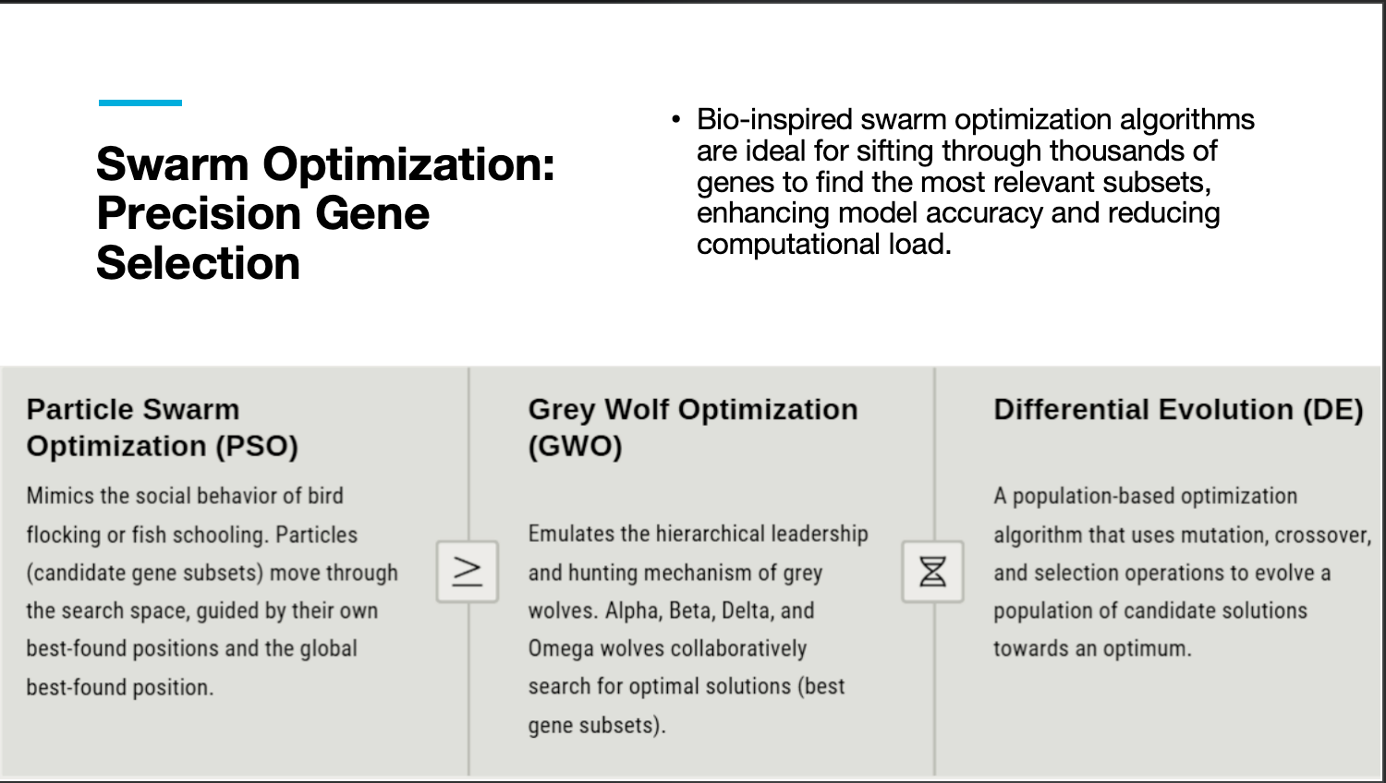

Slide 12
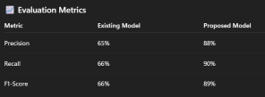
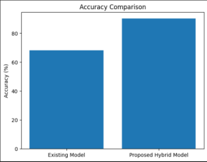
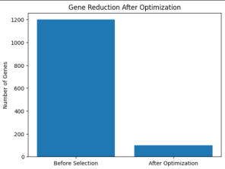
Results

Slide 13
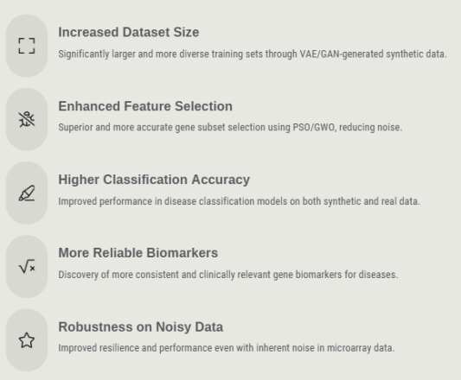
Outcomes

Slide 14
References
  Chat GPT AI
  Bohrium AI
  Xue, B., Zhang, M., Browne, W. N., & Yao, X. (2016) – A Survey on Evolutionary Computation Approaches to Feature Selection, IEEE Transactions on Evolutionary Computation.
  Chuang, L.-Y., Yang, C.-H., & Li, J.-C. (2011) – Chaotic Particle Swarm Optimization for Gene Selection and Classification, Expert Systems with Applications.
  Goodfellow, I., Pouget-Abadie, J., Mirza, M., et al. (2014) – Generative Adversarial Networks, NeurIPS Conference Paper.
  Holland, J. H. (1992) – Adaptation in Natural and Artificial Systems, MIT Press.?(Classic reference for evolutionary optimization methods used in feature selection.)
  Saeys, Y., Inza, I., & Larrañaga, P. (2007) – A Review of Feature Selection Techniques in Bioinformatics, Bioinformatics Journal.
  Kourou, K., Exarchos, T. P., Exarchos, K. P., et al. (2015) – Machine Learning Applications in Cancer Prognosis and Prediction, Computational and Structural Biotechnology Journal

Slide 15
Thank You

